Slide 1
CSE 471 - Lab 09
Windows Navigation Diagram

Slide 2
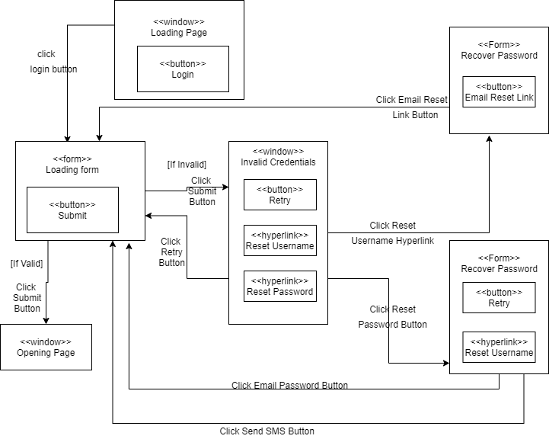

Slide 3
